Slide 1

Modules Summary Discussion – Q&A
CR 5.4
Private and Confidential

Slide 2

Respecting the Elders Dignity
1
Copyright: iCare Life Pte. Ltd., Singapore : This document must not be copied or shared or circulated without the consent of iCare Life and/or its affiliates.

Slide 3
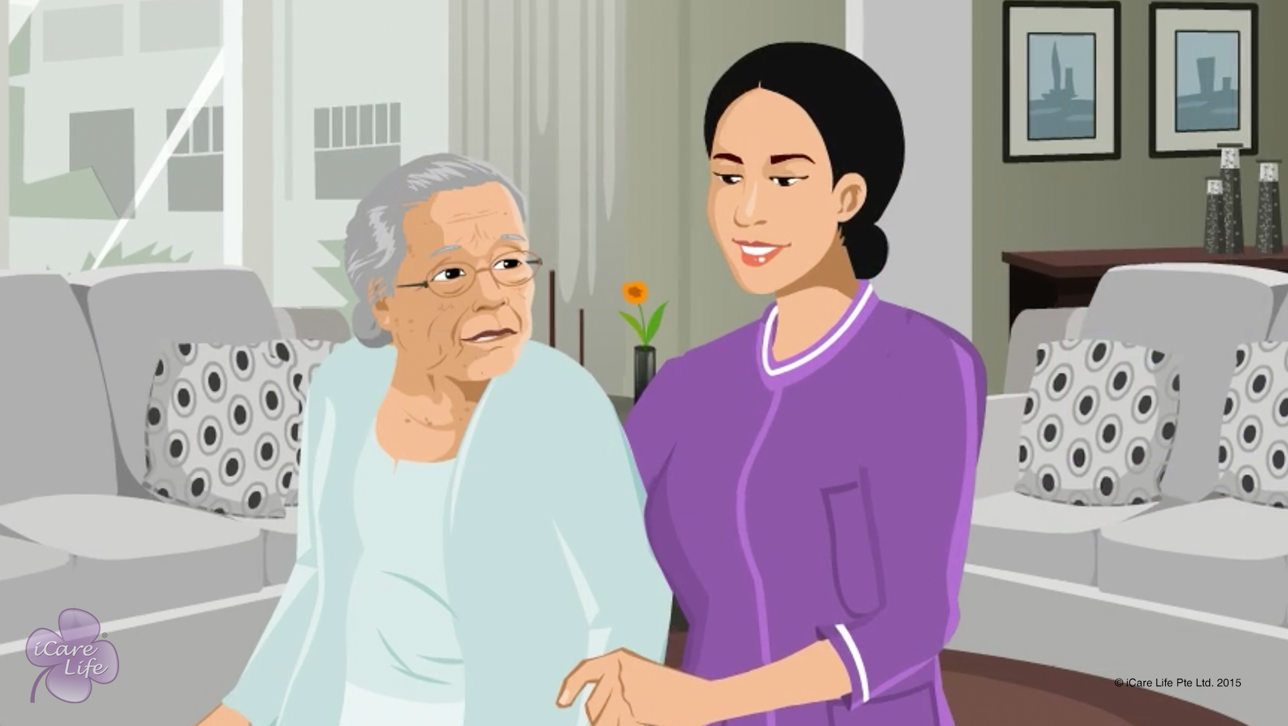
Respecting the Elder’s Dignity
2
Copyright: iCare Life Pte. Ltd., Singapore : This document must not be copied or shared or circulated without the consent of iCare Life and/or its affiliates.

Slide 4
Summary
Respect the elder’s privacy
Do not make fun of the elder’s limitations
Be polite and respectful
Do not share the elder’s problems with others
Ask for the elder’s opinions
Include the elder in a conversation
Never treat the elder as a child
Make the elder feel important
3
Notes:
To respect an elder’s dignity:
Respect the elder’s privacy – knock before entering the elder’s room; give the elder privacy while taking a bath or changing clothes
Do not make fun of the elder’s limitations
Be polite and respectful
Do not share the elder’s problems with others
Ask for the elder’s opinions – give the elder a choice to take decisions about food and daily routine
Include the elder in a conversation
Never treat the elder as a child
Make the elder feel important

Slide 5
Any Questions?
4
Notes:
Q1: The elder in my care insists on doing things that the person can’t do properly. What should I do?
Ans: It is very difficult for the elderly people to accept that they cannot do certain things, which they used to do earlier. If you keep reminding the elder about this limitation, it will frustrate them. The elder may even find this humiliating. If the elder insists on doing something, allow them to do so unless it affects the elder’s safety. If the elder makes a mistake or spills things, be patient and respectful. Instead of reminding the elder about limitations, gently remind the elder that you are there to help. If the elder accepts your help, do not make the elder feel defeated. Encourage the elder to take your help for the difficult part of an activity. For example, if the elder wants to walk without help, encourage the elder to take your help only while going up and down stairs. Make the elder feel it is only for the elder’s convenience and safety.
Q2. What should I say if a visitor or neighbour asks me about the elder’s health or other problems?
Ans: As a caregiver, it is very important for you to win the elder’s trust and keep it. You must never discuss the elder’s health and other problems with others. If the elder comes to know of it, they will feel cheated and humiliated. If a visitor or neighbour asks about such issues, give a general answer. You may say that the elder is managing well or that the elder is working on improvement.

Slide 6
Encouraging Independence in the Elder
5
Copyright: iCare Life Pte. Ltd., Singapore : This document must not be copied or shared or circulated without the consent of iCare Life and/or its affiliates.

Slide 7
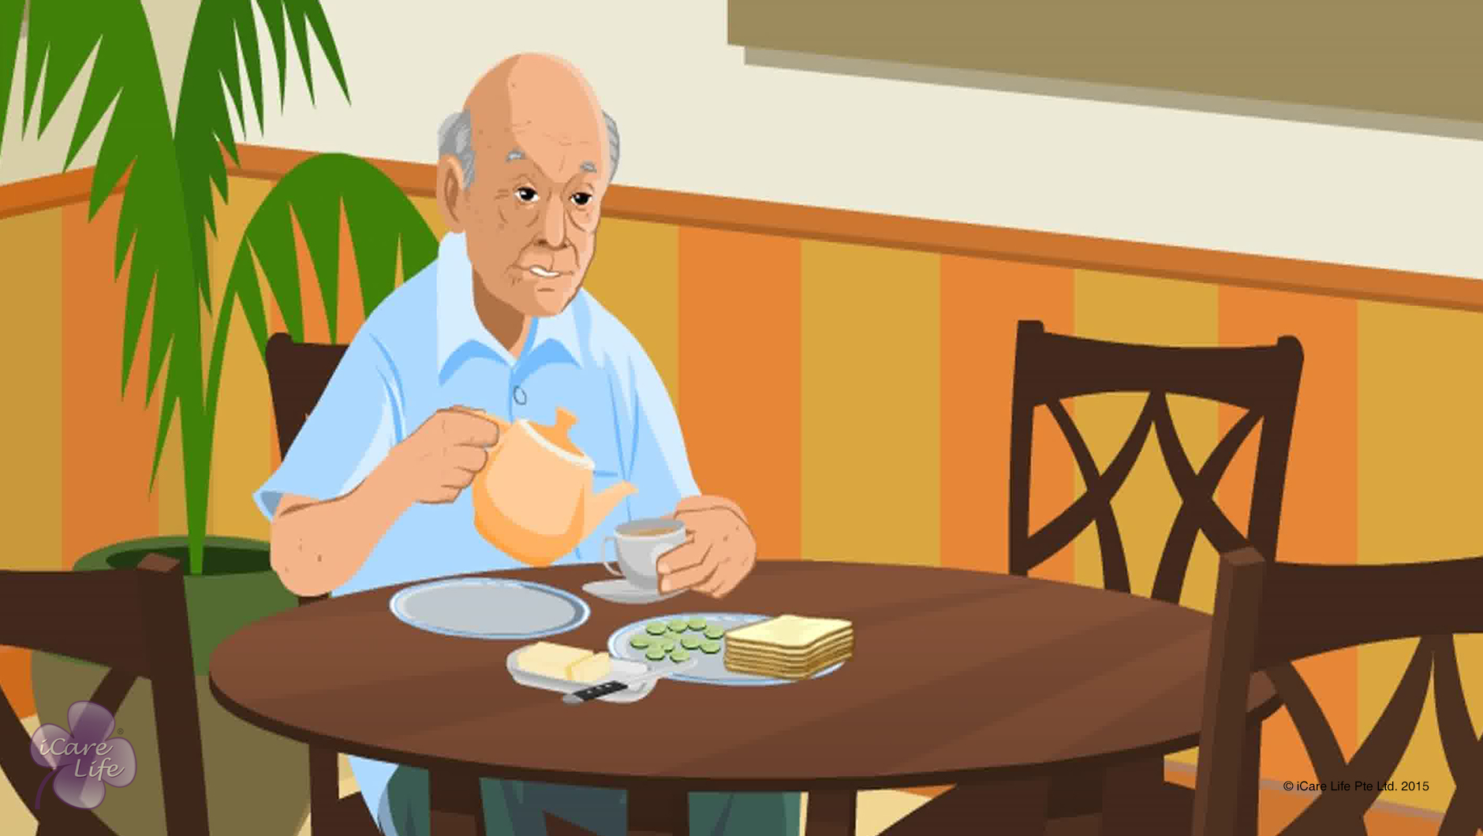
Encouraging Independence in the Elder
6
Copyright: iCare Life Pte. Ltd., Singapore : This document must not be copied or shared or circulated without the consent of iCare Life and/or its affiliates.

Slide 8
Summary
To encourage independence in the elder:
Play the role of a helper
Control the urge to do everything for the elder
Arrange for appropriate devices to help the elder see, hear, and move better
Encourage the person to perform routine activities independently
Encourage the person to eat and serve food independently
Encourage the person to follow a hobby independently
Make sure all things are kept at a comfortable height for the elder
Ask for the elder’s opinion in taking everyday decisions
Do not hurry the person to complete a task
Be patient, encouraging, and appreciative
7
Notes:
To encourage independence in the elder:
Play the role of a helper
Control the urge to do everything for the elder
Arrange for appropriate devices to help the elder see, hear, and move better – any equipment that helps an elder do something more easily is called an assistive device. For example spectacles that help an elder see better; hearing aid that helps an elder listen better; or a walking stick or walker that helps an elder move without anybody else’s support
Encourage the person to perform routine activities independently – routine activities include activities like washing hands, brushing, shaving, bathing and changing clothes
Encourage the person to eat and serve food independently
Encourage the person to follow a hobby independently
Make sure all things are kept at a comfortable height for the elder
Ask for the elder’s opinion in taking everyday decisions
Do not hurry the person to complete a task
Be patient, encouraging, and appreciative

Slide 9
Any Questions?
8
Notes:
Q1. Should I refuse to help the elder in order to encourage independence?
Ans: As a caregiver, your primary role is to take care of the elder. Therefore, you must never refuse to help the elder if the person requires your assistance. Independence should be encouraged, not forced. Assess what the person is comfortable doing and then encourage the person to do those things independently. However, always be around to help in case the elder needs it.

Slide 10
Giving the Right of Choice
9
Copyright: iCare Life Pte. Ltd., Singapore : This document must not be copied or shared or circulated without the consent of iCare Life and/or its affiliates.

Slide 11
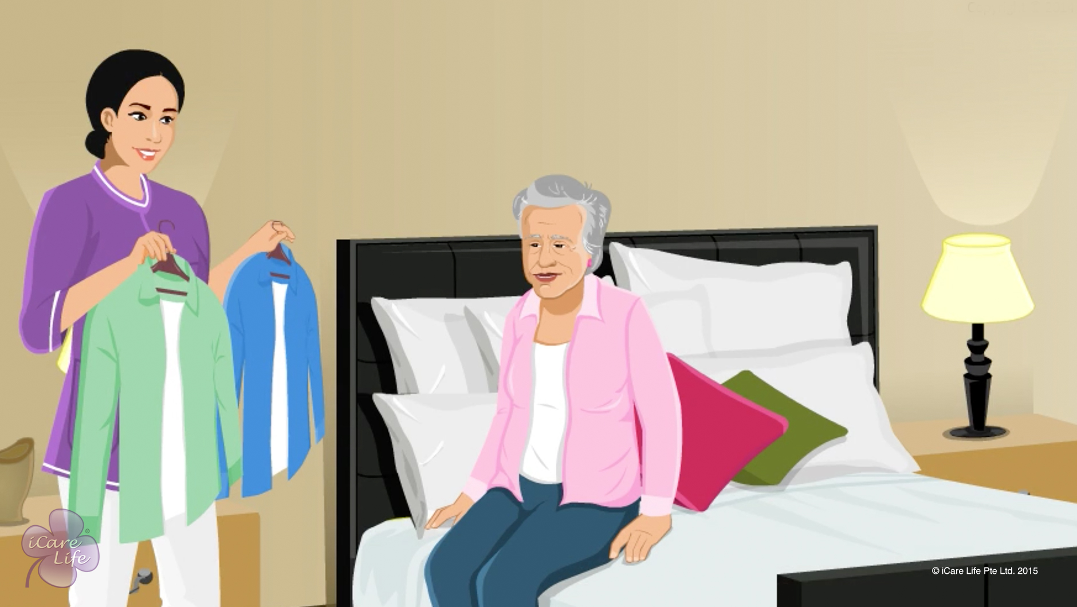
Giving the Right of Choice
10
Copyright: iCare Life Pte. Ltd., Singapore : This document must not be copied or shared or circulated without the consent of iCare Life and/or its affiliates.

Slide 12
Post-Module Activity
Eat
Read
Wear
Exercise
Walk
Sleep
Watch TV
Bathe
Rest
Go out
When
What
Which
Where
Copyright: iCare Life Pte. Ltd., Singapore : This document must not be copied or shared or circulated without the consent of iCare Life and/or its affiliates.

Slide 13
Summary
To respect an elder’s right of choice:
Avoid telling the elder what to do
Ask for the elder’s opinion
Let the elder choose what to eat and wear
Allow the elder to make changes to daily routine
Respect the elder’s right to refuse
Never make fun of the elder’s choice
If the elder’s decision can endanger their safety:
Caution the elder
Stay respectful
Persuade the elder to change the decision
12

Slide 14
Any Questions?
13
Notes:
Q1: If the elder in my care can’t think properly, how can I ask the person to make choices?
Ans: It is easy for people to think that elderly people have no control over their mind. Therefore people assume that elderly people are not fit to make choices or take decisions. Never assume this about an elder under your care. Give the elderly people freedom to choose and then observe their behavior. If you find that the elder gets confused when given too many choices, offer simple choices. For example, if the person gets confused when asked – “What would you like to wear today?” – simplify the choice by asking – “Would you like to wear a white of a blue shirt today?” Do not assume that the elder is not fit to make a choice.

Slide 15
Handling Disagreements with the Elder
14
Copyright: iCare Life Pte. Ltd., Singapore : This document must not be copied or shared or circulated without the consent of iCare Life and/or its affiliates.

Slide 16
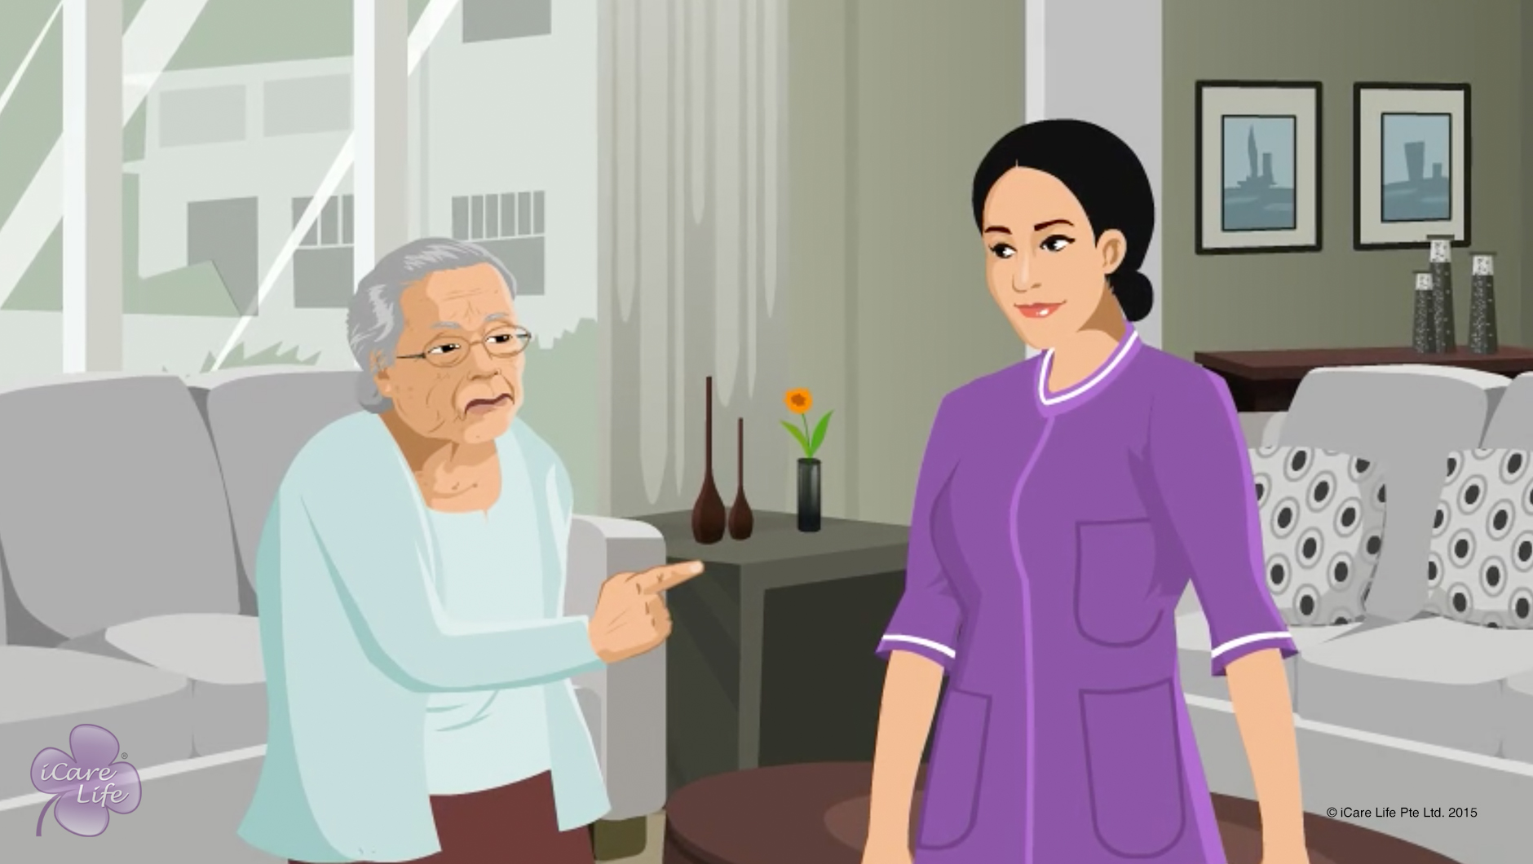
Handling Disagreements with the Elder
15
Copyright: iCare Life Pte. Ltd., Singapore : This document must not be copied or shared or circulated without the consent of iCare Life and/or its affiliates.

Slide 17
Post-Module Activity
Resolve the Disagreement
16
Copyright: iCare Life Pte. Ltd., Singapore : This document must not be copied or shared or circulated without the consent of iCare Life and/or its affiliates.
Notes:
Arrange for a chair and a container containing slips that have the following topics of disagreement written on them:
Disagreement over what to eat (elder likes spicy food)
Disagreement over what to wear (elder likes to dress formally all the time)
Disagreement over when to sleep (elder likes to sleep late)
Disagreement over where to go out
Disagreement over how much TV to watch
Disagreement over wearing spectacles all the time (elder doesn’t want to wear them all the time)
Disagreement over cleanliness of elder’s room (elder feels it is not clean enough)
Disagreement over taking a medicine (elder wants to skip a medicine)
Invite participants in pairs, making sure both are of the same gender. Assign the role of an elder to one of the participants. The person playing the role of the elder takes out a topic for disagreement from the container and shares it with the other participant who plays the role of a caregiver. Allow the caregiver a fixed amount of time, say 5-10 minutes, to understand the elder’s point of view and suggest an amicable solution of the disagreement. The attempt is successful if the elder accepts the solution and unsuccessful if no acceptable solution is reached. In case of an unsuccessful attempt, another participant is invited to play the role of the caregiver. If an acceptable solution is reached, the activity is repeated with a new topic and new pair of participants.

Slide 18
Summary
To resolve a disagreement with an elder:
Find out why the elder disagrees with you
Listen to the elder patiently and without bias and never ridicule the elder’s point of view
State your concerns tactfully and respectfully
Keep calm and use appropriate body language
Find an amicable solution
Convince the elder that you have the person’s best interest in mind
Do not make the person feel that you have won the argument; instead, end the discussion on a positive note
17
Notes:
To resolve a disagreement with an elder:
Find out why the elder disagrees with you
Listen to the elder patiently and without bias
Never ridicule the elder’s point of view
State your concerns tactfully and respectfully
Keep calm
Use appropriate body language – Stand facing the elder and keep your arms to your sides
Find an amicable solution – try and find a solution that accommodates the elder’s wish as much as possible
Convince the elder that you have the person’s best interest in mind
Do not make the person feel that you have won the argument
End the discussion on a positive note

Slide 19
Any Questions?
18
Notes:
Q1. What should I do if the elder disagrees with me over everything?
Ans: It is easier to resolve a disagreement that happens once in a while over a specific issue. If the elder is in a habit of disagreeing with you, you must change certain things about your day to day behavior. Some elders do not like to do what they are told. Therefore, instead of making suggestions, ask for suggestions from the elder. For example, instead of telling them what to eat for breakfast, ask the elder what the person would like to have. Similarly, instead of asking the elder to lie down and rest, ask if the person would like to rest for a while. This way the elder will be taking the decisions and will have no reason to disagree with you.

Slide 20
Handling disrespectful behavior
19
Copyright: iCare Life Pte. Ltd., Singapore : This document must not be copied or shared or circulated without the consent of iCare Life and/or its affiliates.

Slide 21
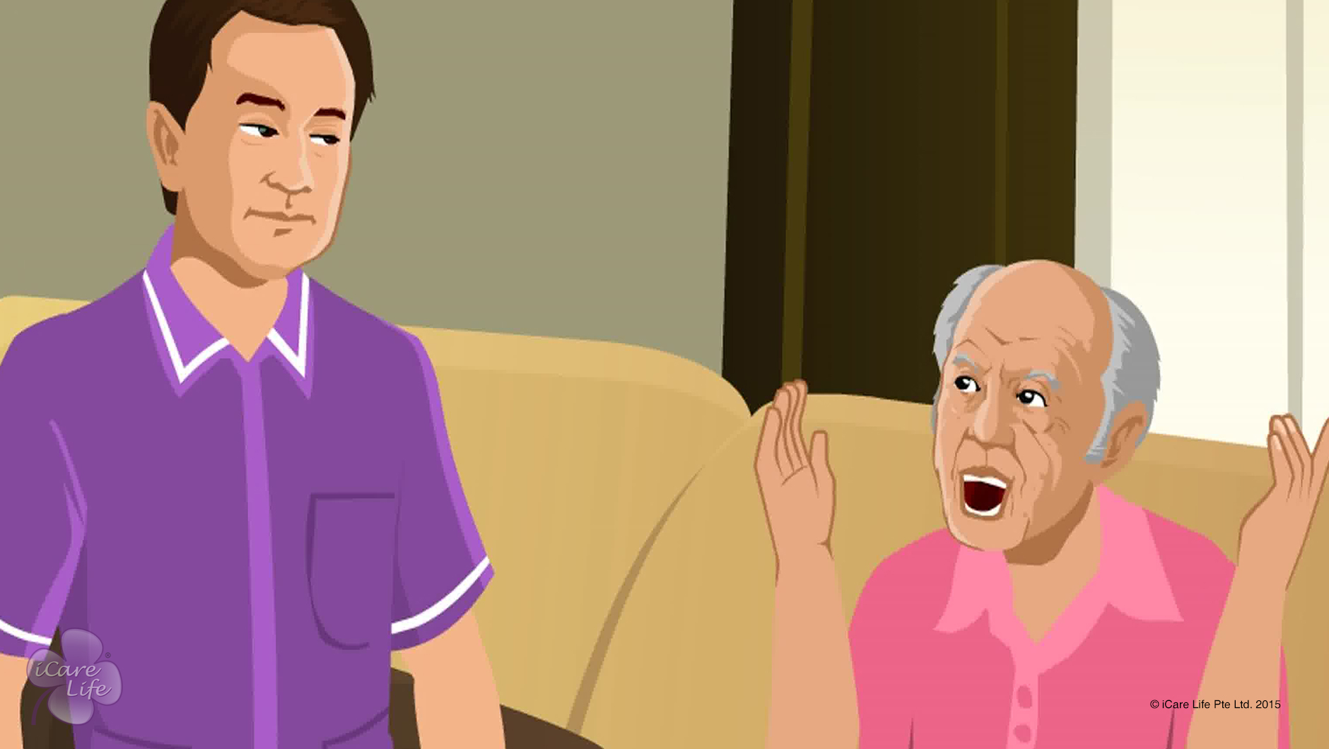
Handling disrespectful Behavior
20
Copyright: iCare Life Pte. Ltd., Singapore : This document must not be copied or shared or circulated without the consent of iCare Life and/or its affiliates.

Slide 22
Post-Module Activity
My Story
Yesterday the Elder under my Care treated me disrespectfully
….Everything ended well ultimately
21
Copyright: iCare Life Pte. Ltd., Singapore : This document must not be copied or shared or circulated without the consent of iCare Life and/or its affiliates.
Notes:
Arrange for following material: Loose sheets of paper, pencils or pens
Divide the participants into groups of 4-5 each. Introduce the activity by its title – My Story! Ask members to each group to create a short story that begins with the sentence “Yesterday the elder in my care treated me disrespectfully…” and ends with “All became well in the end.”
The participants can create the story verbally, or use paper and writing material to write down the points. Tell the participants that each story must have three clear parts:
1. How was the elder’s behavior insulting? – This will help the participants will anticipate examples of disrespectful behavior and become mentally prepared to expect such behavior in real life.
2. What was your response to the disrespectful behavior?
3. How did you control your emotions?
Give the participants around 15 minutes to discuss and come up with a story. Each group must choose a representative to narrate the group's story. Invite representatives from each group one by one to narrate the story. After each narration, allow a time of five minutes for the participants to discuss the story and point out examples of correct or incorrect behavior.
At the end of the activity, draw the attention of all participants to the last statement in each story – “All became well in the end.” Tell them to keep the same approach and try to bring every situation to a happy ending.

Slide 23
Summary
Stress and frustration, a new illness or medicine, and anger towards you or others, are some of the reasons for disrespectful behavior
To correct disrespectful behavior:
Ask what has offended the elder
Apologize if you have made a mistake
Arrange for a checkup or review of medication
Tell the elder you find the behavior disrespectful
Set a clear boundary for the behavior you expect
To keep your emotions in control:
Be prepared to expect any kind of odd behavior
Do not take the disrespect personally
Find ways to control your anger
Never ignore disrespectful behavior
22
Notes:
Stress and frustration, a new illness or medicine, and anger towards you or others, are some of the reasons for disrespectful behavior
To correct disrespectful behavior:
Ask what has offended the elder
Apologize if you have made a mistake
Arrange for a checkup or review of medication – talk to a family member to schedule an appointment with the elder’s doctor
Tell the elder you find the behavior disrespectful – speak in a direct, but respectful manner
Set a clear boundary for the behavior you expect – convey this politely but clearly to the elder
To keep your emotions in control:
Be prepared to expect any kind of odd behavior
Do not take the disrespect personally
Find ways to control your anger – try deep breathing, having a glass of water, or excusing yourself for a few minutes to calm yourself
Never ignore disrespectful behavior

Slide 24
Any Questions?
23
Notes:
Q1: What should I do if the elder is habitually disrespectful towards everybody including me?
Ans: Being disrespectful can also be a personality trait with some people. In this case also:
Tell the elderly person clearly and respectfully that find the behavior disrespectful
Respectfully tell the person how you wish to be treated
If the elder does not change the disrespectful behavior and you find yourself unable to cope with it, talk to your employer. Explain the situation clearly and state how it is affecting your own emotional balance.

Slide 25
Shaving the Elder
24
Copyright: iCare Life Pte. Ltd., Singapore : This document must not be copied or shared or circulated without the consent of iCare Life and/or its affiliates.

Slide 26
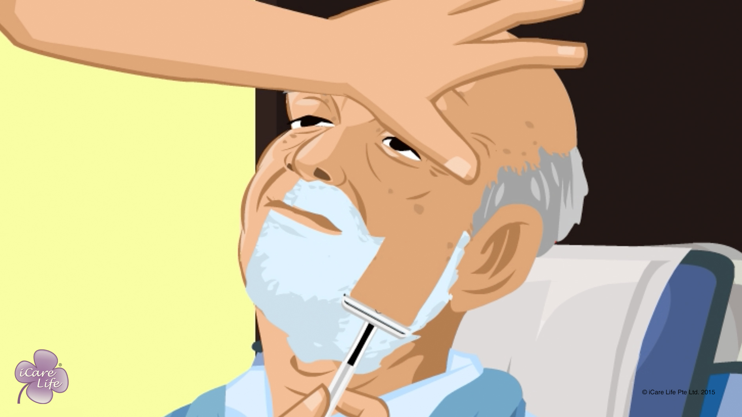
Shaving the Elder
25
Copyright: iCare Life Pte. Ltd., Singapore : This document must not be copied or shared or circulated without the consent of iCare Life and/or its affiliates.

Slide 27
Post-Module Activity
Practical Training
26
Copyright: iCare Life Pte. Ltd., Singapore : This document must not be copied or shared or circulated without the consent of iCare Life and/or its affiliates.
Notes:
The participants are given a live demonstration of using different kinds of razors and shaving elderly people sitting up and lying down in bed by trained caregivers. The ideal place for this would be an old people’s home or a nursing home. Fix a prior appointment for the activity and inform the participants of the location and timings for the demonstration.
During the demonstration, participants can be assigned tasks like finding out an elder’s preference and collecting all the items required for shaving an elder. If additional subjects are available, one by one the participants can shave elderly people under the supervision of a trained caregiver.

Slide 28
Summary
To shave the elder, you need:
Shaving foam, shaving cream, gel, or pre-shave lotion
Electric razor or safety razor
A shaving brush
A basin of water
Aftershave lotion
A thick towel
A hand towel
27
Notes:
Stress and frustration, a new illness or medicine, and anger towards you or others, are some of the reasons for disrespectful behavior
To correct disrespectful behavior:
Ask what has offended the elder
Apologize if you have made a mistake
Arrange for a checkup or review of medication – talk to a family member to schedule an appointment with the elder’s doctor
Tell the elder you find the behavior disrespectful – speak in a direct, but respectful manner
Set a clear boundary for the behavior you expect – convey this politely but clearly to the elder
To keep your emotions in control:
Be prepared to expect any kind of odd behavior
Do not take the disrespect personally
Find ways to control your anger – try deep breathing, having a glass of water, or excusing yourself for a few minutes to calm yourself
Never ignore disrespectful behavior

Slide 29
Summary
To shave the elder:
Moisten the elder’s beard using warm water
Lather the elder’s face
Shave down the cheeks towards chin
Shave up from the base of the neck towards chin
Rinse safety razor after each stroke
Wipe off extra lather using the hand towel
Apply aftershave lotion
While shaving the elder:
Make the elder wear dentures if the elder uses them normally
Hold the elder’s skin taut before each stroke
Use short strokes
Apply gentle pressure
Apply pressure using a tissue to stop bleeding from nicks and cuts
28
Notes:
Stress and frustration, a new illness or medicine, and anger towards you or others, are some of the reasons for disrespectful behavior
To correct disrespectful behavior:
Ask what has offended the elder
Apologize if you have made a mistake
Arrange for a checkup or review of medication – talk to a family member to schedule an appointment with the elder’s doctor
Tell the elder you find the behavior disrespectful – speak in a direct, but respectful manner
Set a clear boundary for the behavior you expect – convey this politely but clearly to the elder
To keep your emotions in control:
Be prepared to expect any kind of odd behavior
Do not take the disrespect personally
Find ways to control your anger – try deep breathing, having a glass of water, or excusing yourself for a few minutes to calm yourself
Never ignore disrespectful behavior

Slide 30
Any Questions?
29
Notes:
Q1. How can I avoid nicks and cuts on an elder’s face while shaving?
Ans: Take time to soften the elder’s beard using warm water and build up a good lather. Hold the skin taut and apply very gentle pressure while shaving. Change the blade of a safety razor frequently. Rinse the safety razor after each stroke so that the blades do not get clogged by hair. Use a high quality razor. Cheap, use and throw away razors have inferior quality blades that often cause more nicks and cuts. If possible, use an electric razor. Most importantly, do not get distracted while shaving the elder.

Slide 31
Caring for Bed Sores
30
Copyright: iCare Life Pte. Ltd., Singapore : This document must not be copied or shared or circulated without the consent of iCare Life and/or its affiliates.

Slide 32
Post-Module Activity
Demonstration
Copyright: iCare Life Pte. Ltd., Singapore : This document must not be copied or shared or circulated without the consent of iCare Life and/or its affiliates.
Notes:
You will need to set up an appointment with a medical professional/ nurse/caregiver who can demonstrate the handling of a patient with bed sores. You will also require a mattress for the demonstration.
Call for a class participant (or use a human dummy) to facilitate the demonstration with the caregiver. The class participant should lie down on the mattress. The caregiver can demonstrate:
How to turn a bedridden elder to prevent bed sores
Considerations you should keep in mind while tending an elder who has bed sores
How to care for a bed sore

Slide 33
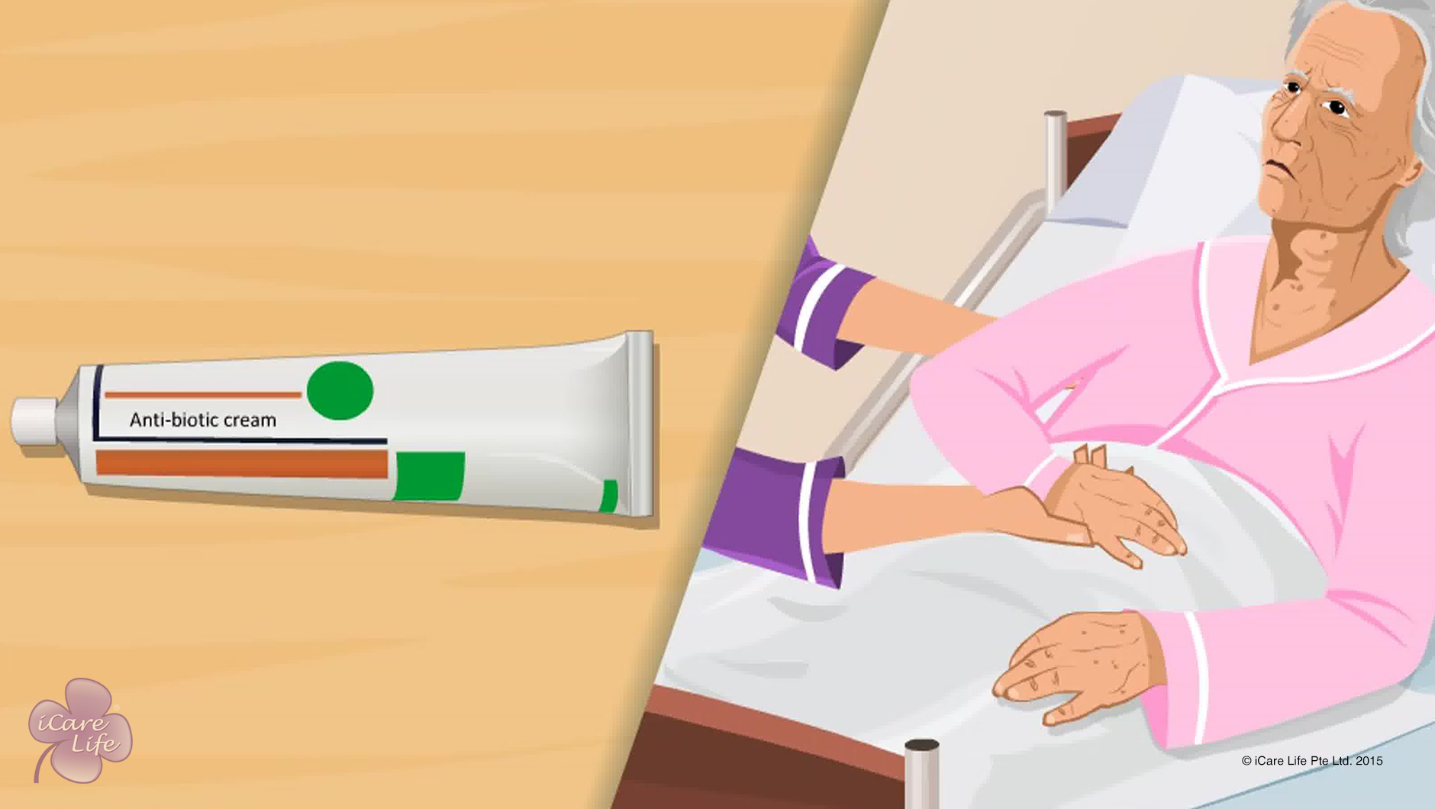
Caring for Bed Sores
32
Copyright: iCare Life Pte. Ltd., Singapore : This document must not be copied or shared or circulated without the consent of iCare Life and/or its affiliates.

Slide 34
Summary
Every day, check the parts of the body likely to get bed sores
Dry the elder’s wet skin and apply moisturizer
Massage the elder’s body with oil once a week in winter and once a month in summer
Dry with talcum powder
Move the body parts that are in contact with the bed every two to three hours
Inform the elder’s family if the sore is at an advanced stage
Request for a water bed or a mattress filled with air
Apply an anti-biotic cream or lotion to a bed sore
33
Notes:
Every day, check the parts of the body likely to get bed sores
Dry the elder’s wet skin and apply moisturizer
Massage the elder’s body with oil once a week in winter and once a month in summer
Dry with talcum powder
Move the body parts that are in contact with the bed every two to three hours
Inform the elder’s family if the sore is at an advanced stage
Request for a water bed or a mattress filled with air
Apply an anti-biotic cream or lotion to a bed sore

Slide 35
Any Questions?
34
Notes:
Q1. What are possible complications in case bed sores are left untreated?
Ans. Untreated bed sores can lead to following complications: -
(a) Sepsis (bacteria entering the blood stream)
(b) Cellulitis ( inflammation of the body tissue, causing swelling and redness)
(c) Bone and joint infections
(d) Abscess ( a collection of pus)
(e) Cancer (squamous cell carcinoma)
Q2. Can poor hygienic conditions aggravate bed sores?
Ans. Poor hygienic conditions can aggravate bed sores and are in fact one of the primary reasons for bed sores.
Q3. When should the caregiver contact a doctor?
Ans. Bed sores are difficult to treat. If you see any kind of redness, where skin does not blanch when touched and it may be tender and painful, it is an indication of a bed sore. If the symptoms do not go away within 48 hours, you must call a doctor.

Slide 36
Home Safety of the Elder
35
Copyright: iCare Life Pte. Ltd., Singapore : This document must not be copied or shared or circulated without the consent of iCare Life and/or its affiliates.

Slide 37
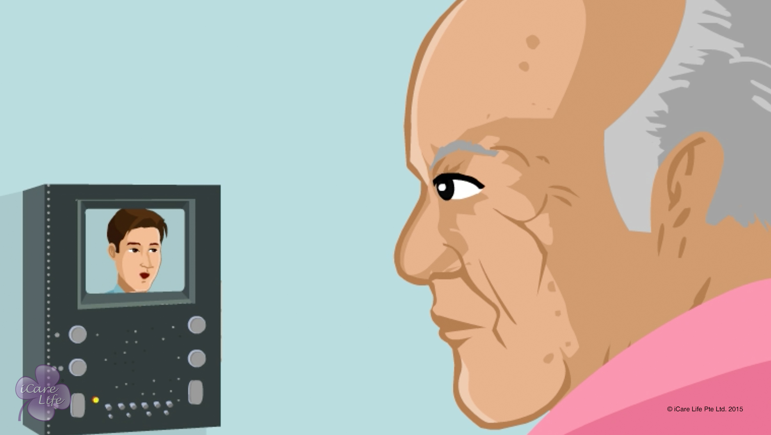
Home Safety of the Elder
36
Copyright: iCare Life Pte. Ltd., Singapore : This document must not be copied or shared or circulated without the consent of iCare Life and/or its affiliates.

Slide 38
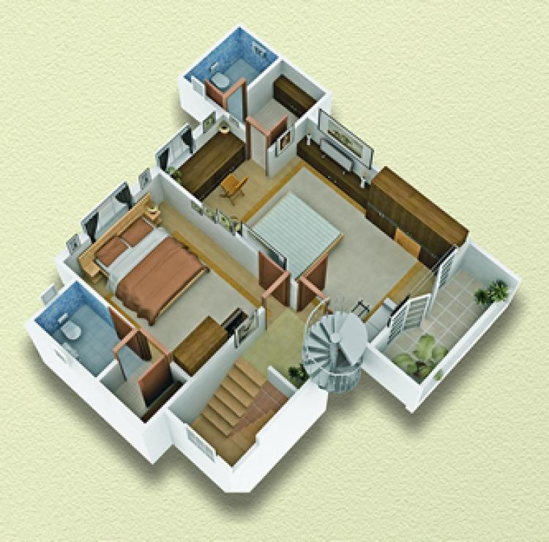
Post-Module Activity
Identify the problem Areas
Copyright: iCare Life Pte. Ltd., Singapore : This document must not be copied or shared or circulated without the consent of iCare Life and/or its affiliates.
Notes:
Draw the participants’ attention to the image in the screen. Explain that this is a view showing different areas of a house. Ask the participants to identify the problem areas that can be a concern for the elder’s safety and suggest ways to make those areas safe.
Invite the participants’ responses.
If required, point at the bathroom, staircase, bedroom, living area, doorways and windows and ask what kind of safety risk they can cause to the elder. Also ask how these areas can be made more safe for the elder.
A few possible responses can be:
Bathroom: Risk – Fall; Precautions – Grab bars, nonskid mats
Staircase: Risk – Fall; Precautions – Brightly coloured stickers on steps
Bedroom: Risks – Fall, Fire, Earthquake; Precautions: Fix rugs to floor, keep a fire extinguisher handy, have a planned exit route
Living area: Risks – Fall; Precautions – Fix rugs and carpets to the floor, clean all spills immediately
Doorways: Risk – Fall; Precautions – Keep doorways uncluttered
Windows: Risk: Entry of criminals; Precautions – Keep windows closed when elder is alone, have iron grills fitted in windows

Slide 39
Summary
Every day, check the parts of the body likely to get bed sores
To ensure safety against falls:
Fix all rugs and carpets to the floor using double-sided tape
Put brightly-colored stickers where the floor level changes
Get grab bars installed in the bathroom
Place nonskid mats inside and just outside the bathroom
Clean up all spills of water or other liquids immediately
Keep all passages clear
Fix all loose cords and wires to the wall
38
Notes:
To ensure safety against falls:
Fix all rugs and carpets to the floor using double-sided tape
Put brightly-colored stickers where the floor level changes
Get grab bars installed in the bathroom
Place nonskid mats inside and just outside the bathroom
Clean up all spills of water or other liquids immediately
Keep all passages clear
Fix all loose cords and wires to the wall

Slide 40
Summary
To ensure safety against fire and earthquake:
Smoke alarms must be installed in all areas of the house
Place fire extinguishers in the kitchen, the elder’s bedroom and near the main door
Keep all areas of the house well lit
Plan an exit route to get the elder quickly out of the house
To ensure safety against crime:
Shut all doors and windows securely before leaving the elder alone in the house
Make sure that the elder has easy access to a telephone
Have a door answering system installed at the main door
39
Notes:
To ensure safety against fire and earthquake:
Smoke alarms must be installed in all areas of the house
Place fire extinguishers in the kitchen, the elder’s bedroom and near the main door
Keep all areas of the house well lit
Plan an exit route to get the elder quickly out of the house
To ensure safety against crime:
Shut all doors and windows securely before leaving the elder alone in the house
Make sure that the elder has easy access to a telephone
Have a door answering system installed at the main door

Slide 41
Any Questions?
40
Notes:
Q.1. What should I do if the elder does not agree to my suggestions of making some changes in the house to make it safer for the elder?
Ans. You should talk to the elder’s family and explain the reasons and importance of your suggestions. Ask the family members to convince the elder.

Slide 42
Handling falls of the Elder
41
Copyright: iCare Life Pte. Ltd., Singapore : This document must not be copied or shared or circulated without the consent of iCare Life and/or its affiliates.

Slide 43
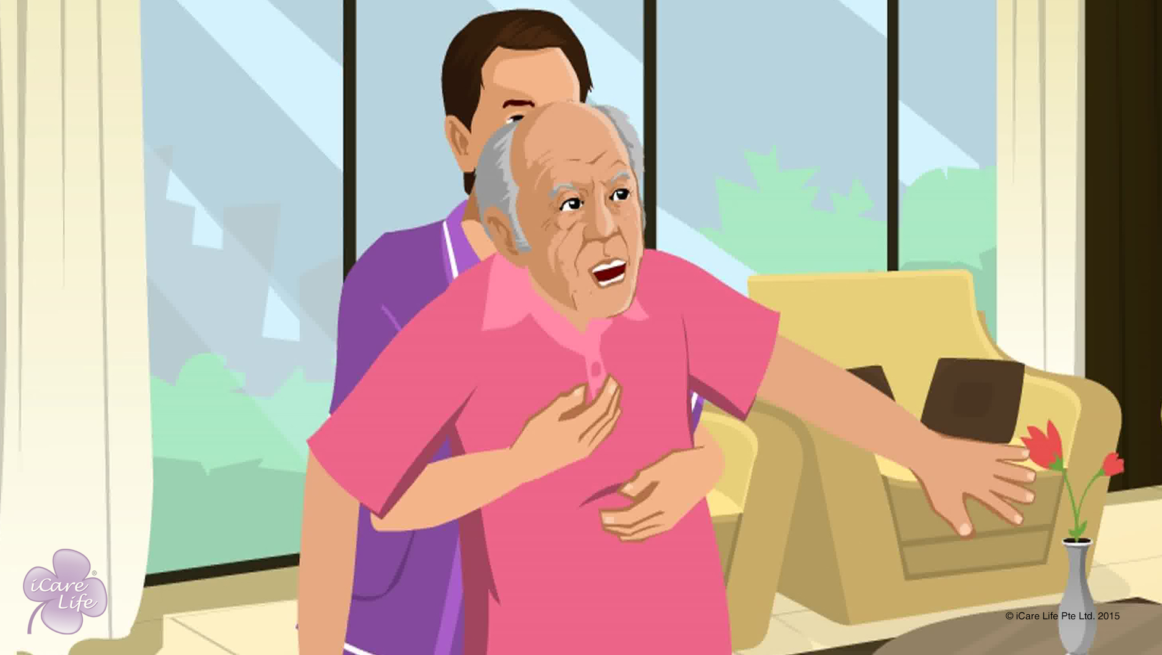
Handling falls of the Elder
42
Copyright: iCare Life Pte. Ltd., Singapore : This document must not be copied or shared or circulated without the consent of iCare Life and/or its affiliates.

Slide 44
Post-Module Activity
Let’s Practice
Copyright: iCare Life Pte. Ltd., Singapore : This document must not be copied or shared or circulated without the consent of iCare Life and/or its affiliates.
Notes:
Material required: A thick mattress, a sturdy chair
If possible, arrange for two trained caregivers to demonstrate how to assist a person during and after a fall.
Next, invite participants in pairs to play the role of a caregiver and elderly person. Make sure the two participants at a time are both men or both women.
The person playing the part of the elder stands on the middle of the mattress and pretends to fall. The participant can choose the direction of fall. The participant playing caregiver needs to assist the elderly during the fall.
During this phase point out any attempt to grab the falling person. Also point out whether the caregiver has managed to support the falling person’s head or not.
After the fall, the participant playing the elderly person can choose to be injured, able to get up without help or require help to get up. Depending on the situation, the person playing caregiver’s role needs to take appropriate action.
Point out any mistake in the caregiver’s actions in calling for emergency services (if the person is injured), correct way of making the person get up (if the person can get up without help), or calling for additional help (if the person cannot get up without help).
Ensure all participants get a turn to play the role of a caregiver.

Slide 45
Summary
If the elder is falling:
Support the elder’s head and
Let the elder fall against your body
If the elder falls:
Check for injury and bleeding
In case of injury, call emergency services
Do not hurry to get the elder up
If the elder can get up without help:
Ask the elder to roll to a side
Sit up in kneeling position
Get up using the support of a chair
Call another person for assistance if the elder cannot get up without help
44
Notes:
If the elder is falling:
Support the elder’s head and
Let the elder fall against your body
If the elder falls:
Check for injury and bleeding
In case of injury, call emergency services
Do not hurry to get the elder up
If the elder can get up without help:
Ask the elder to roll to a side
Sit up in kneeling position
Get up using the support of a chair
Call another person for assistance if the elder cannot get up without help

Slide 46
Any Questions?
45
Notes:
Q1. Should I help the elder even if the person wants to get up without any help?
Ans: You must respect the elder’s spirit of independence. Do not insist on helping the person. Guide the person in getting up safely as taught in the module. If you find the person is not being able to get up safely, offer your help again. If you are very sure the person will not be able to get up safely without help, explain the situation to the elder and get additional help.

Slide 47
Preventing Falls of the Elder
46
Copyright: iCare Life Pte. Ltd., Singapore : This document must not be copied or shared or circulated without the consent of iCare Life and/or its affiliates.

Slide 48
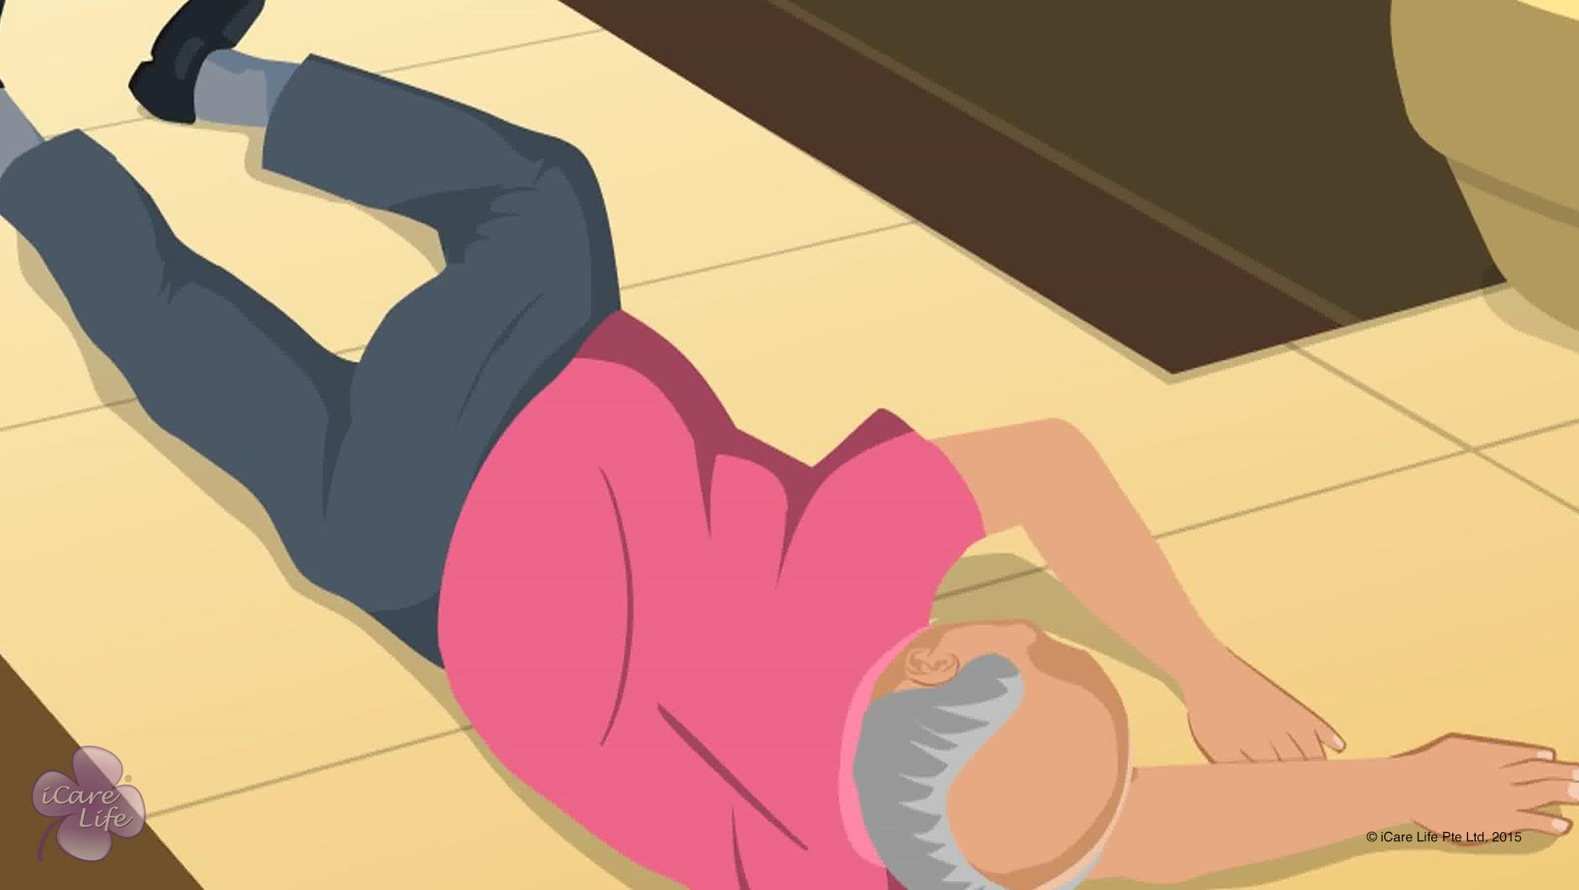
Preventing Falls of the Elder
47
Copyright: iCare Life Pte. Ltd., Singapore : This document must not be copied or shared or circulated without the consent of iCare Life and/or its affiliates.

Slide 49
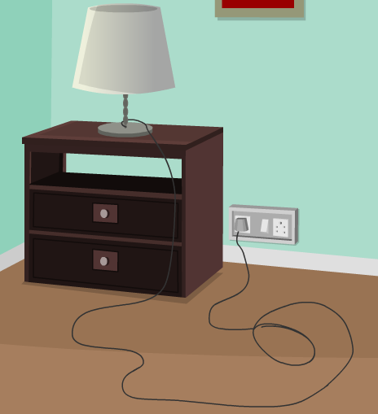
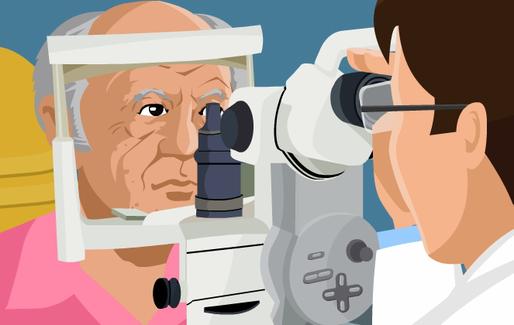

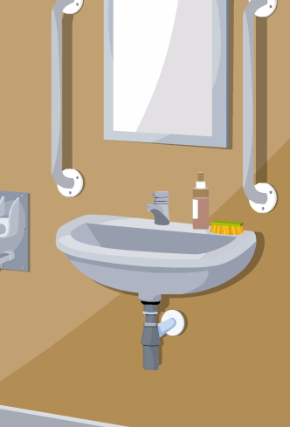
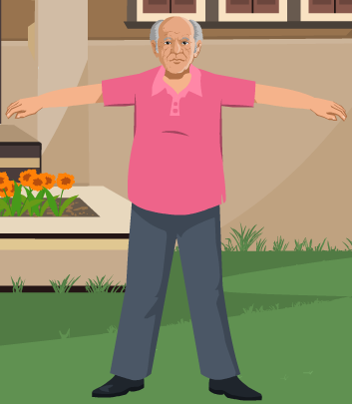

Post Module activity
Spot the Risks!
48
Copyright: iCare Life Pte. Ltd., Singapore : This document must not be copied or shared or circulated without the consent of iCare Life and/or its affiliates.
Notes:
Draw the attention of the participants to the collage images on the screen. The collage shows loose wires, an eye checkup, loose carpet on staircase, a grab bar, a man exercising and a poorly lit passage. Read the instruction on the screen aloud – Spot the risks!
Explain that the participants have to identify the pictures which indicate a risk that may lead to a fall. Also the participants have to identify why a picture does or does not indicate a risk.
Ask for responses from the participants. The objective is to make the participants identify the pictures as follows:
Loose wires – Risk as a person’s foot can get entangled and the person can trip
An eye checkup – Not a risk. Periodic eye-check are advised to maintain good eyesight and avoid falls
Water on the floor – Risk as a person may slip and fall
A grab bar – Not a risk. Grab bars are installed to provide extra support while getting up, sitting down and walking
A man exercising – Not a risk. Regular exercise increases bone and muscle strength that can prevent a fall
A poorly lit passage – Risk as a person may not be able to see clearly and trip over something

Slide 50
Summary
To prevent the elder from falling due to health reasons:
Take the elder for regular eye checkup
Include foods rich in calcium in the elder’s diet
Take the elder out in sunshine regularly
Encourage the elder to exercise regularly
Seek review of medications causing drowsiness
To prevent the elder from falling due to disorderly surroundings:
Keep the house uncluttered
Secure loose wires and cords
Fix carpets and rugs to the floor
Put brightly-colored stickers on each step in a staircase
Have grab bars installed in bathrooms and toilets
Keep all areas of house well illuminated
Have a bedside light installed for the elder
Keep all things at a comfortable height for the elder
49
Notes:
To prevent the elder from falling due to health reasons:
Take the elder for regular eye checkup
Include foods rich in Calcium in the elder’s diet
Take the elder out in sunshine regularly
Encourage the elder to exercise regularly
Seek review of medications causing drowsiness – Side effects of some medicines can make the elder sleepy or have vertigo. This can make an elder lose balance and fall.
To prevent the elder from falling due to disorderly surroundings:
Keep the house uncluttered
Secure loose wires and cords
Fix carpets and rugs to the floor
Put brightly colored stickers on each step in a staircase
Have grab bars installed in bathrooms and toilets
Keep all areas of house well illuminated
Have a bedside light installed for the elder
Keep all things at a comfortable height for the elder

Slide 51
Any Questions?
50
Notes:
Q.1. What should I do if the elder under my care refuses my help, even when they are prone to falls?
Ans. The elder may be refusing to accept their susceptibility to falling. Do not force the elder to hold your hand; however, you must always stay nearby to help in case they need it.

Slide 52
Support the Elder in Walking
51
Copyright: iCare Life Pte. Ltd., Singapore : This document must not be copied or shared or circulated without the consent of iCare Life and/or its affiliates.

Slide 53
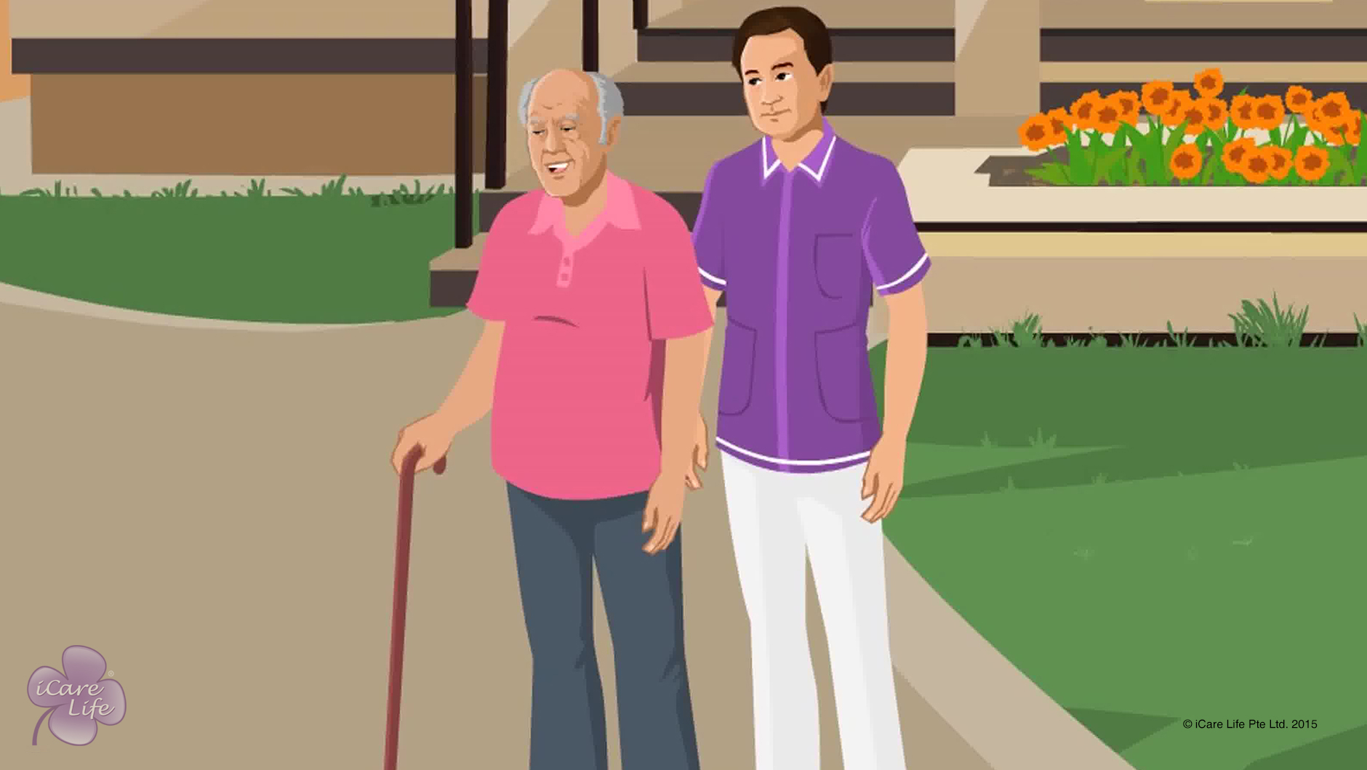
Support the Elder in Walking
52
Copyright: iCare Life Pte. Ltd., Singapore : This document must not be copied or shared or circulated without the consent of iCare Life and/or its affiliates.

Slide 54
Post Module activity
Let’s Practice
53
Copyright: iCare Life Pte. Ltd., Singapore : This document must not be copied or shared or circulated without the consent of iCare Life and/or its affiliates.
Notes:
The participants are divided into three groups. One person is made the elder from each group and another person is made the caregiver.
Group 1: The elder can walk independently without any walking aids.
Group 2: The elder uses a walking stick
Group 3: The elder uses a walker
The other people in the group provide feedback and inputs to the caregiver on what was done correctly and what was incorrect.

Slide 55
Summary
Prevent the elder from falls
Conditions such as arthritis, spinal problems, muscular problems, and balance and coordination problems can restrict the elder’s ability to walk independently
Explain to the elder that you will help them walk
Ensure that the elder is wearing comfortable, non-skid and well-fitting shoes
Ensure that the surface is smooth and even so that the elder does not stumble or have to look down while walking
Make sure that the elder has both feet firmly planted on the floor
Walk behind and to one side of the elder; support the elder’s weaker side
Let the elder set the pace
54
Notes:
Prevent the elder from falls – Elders take much longer to recover from falls
Conditions such as arthritis, spinal problems, muscular problems, and balance and coordination problems can restrict the elder’s ability to walk independently
Explain to the elder that you will help them walk
Ensure that the elder is wearing comfortable, non-skid, and proper fitting walking shoes
Ensure that the surface is smooth and even so that the elder does not stumble or have to look down while walking
Make sure that the elder has both feet firmly planted on the floor
Walk behind and to one side of the elder; support the elder’s weaker side
Let the elder set the pace – Do not hurry or rush them

Slide 56
Summary
If the elder does not have the strength or stability to support themselves, they might need to use a walking stick or cane
If they require more support, they could use a walker
When assisting an elder who is using a walker, ensure that the elder stays inside the frame of the walker
If the elder needs a lot of support while walking, use a gait belt
Maintain a firm grip on the gait belt
Always be prepared for a fall
Be observant; the elder might tire easily and only be able to handle short walks
55
Notes:
If the elder does not have the strength or stability to support themselves, they might need to use a walking stick or cane
If they require more support, they could use a walker
When assisting an elder who is using a walker, ensure that the elder stays inside the frame of the walker
If the elder needs a lot of support while walking, use a gait belt
Maintain a firm grip on the gait belt
Always be prepared for a fall
Be observant; the elder might tire easily and only be able to handle short walks

Slide 57
Any Questions?
56
Notes:
FAQs
Q1. The elder refuses to let me hold them. They are comfortable using the walker. Can I let them walk independently?
Since the elder is using a walker, there is always a concern that they might fall. You should walk on their weaker side to support them if needed.
Q2. There is a small hill around the elder’s house. Can I let them walk on that hill?
Ideally, you should ensure that the elder walks on a smooth, even path.
Q3. The elder is extremely slow while walking. They stop to look at every single plant and thing on the road. Should I tell them to focus their attention on walking?
A. A walk is a method for the elder to relax. Do not force them to continue walking. Let them take their time as they walk.

Slide 58


